Slide 1
DDL room layout
Birds-eye view

Slide 2
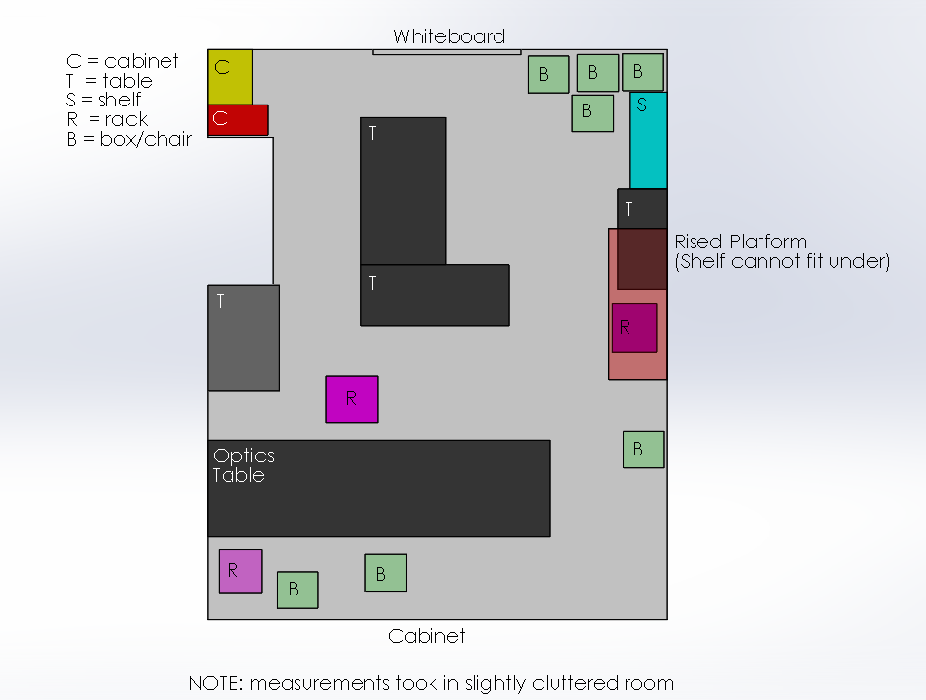
Original Layout

Slide 3
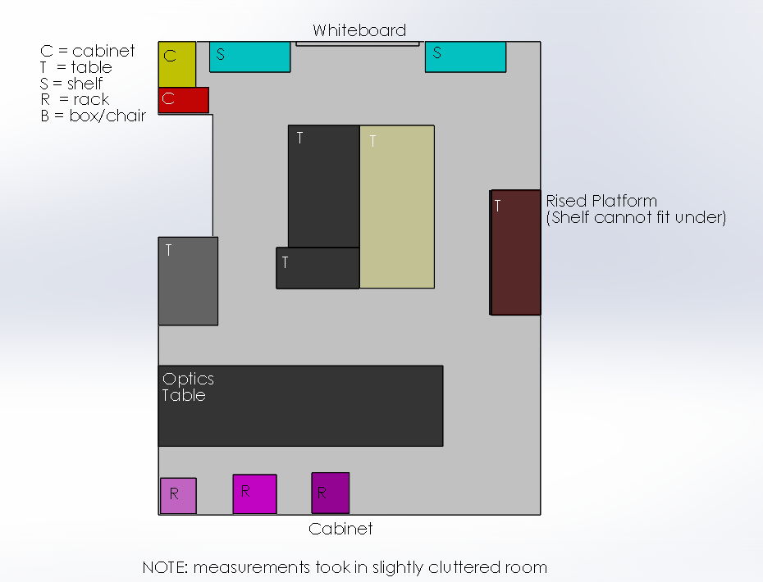
Possible New Layout
More shelf
space
SWAPPED

Slide 4

Suggestions?
Testing Rack?

